Slide 1


Model Transformation By Demonstration: A User-Centric Approach to Support Model Evolution
Committee
Dr. Purushotham Bangalore (Chair)
Dr. Barrett Bryant
Dr. Jeff Gray
Dr. Marjan Mernik
Dr. Jules White
Dr. Chengcui Zhang
Dr. Robert France (External Reviewer)
Dr. Aniruddha Gokhale (External Reviewer)
Yu Sun
yusun@cis.uab.edu
Dissertation Research Defense
November 4, 2011
This research is supported by
NSF CAREER award CCF-1052616
University of Alabama at Birmingham
Software Composition and Modeling Lab

Slide 2
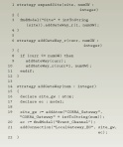
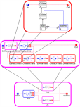
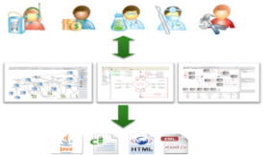
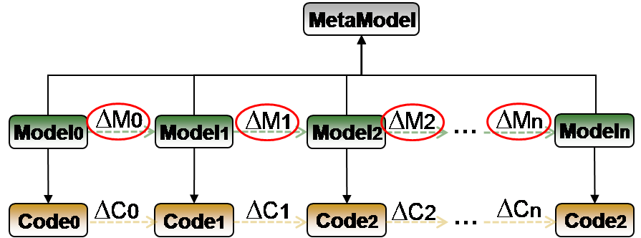

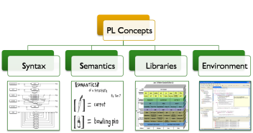




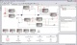
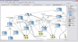


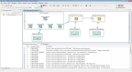
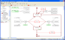
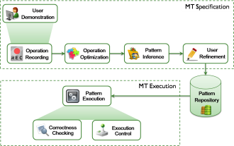
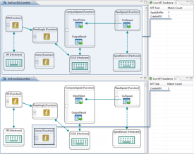
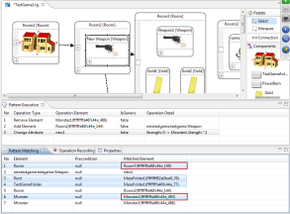

Roadmap
Introduction
Model Transformation Languages (MTLs)
Domain-Specific Modeling
Model Evolution
Motivation
Using and learning MTLs
Reusing MTL Rules
Debugging MTL Rules
Research Objectives
User-Centric
Reuse Support
Debugging Mechanism
Approaches
MTBD
Live-MTBD
MTBD Debugger

Slide 3
Raising the Level of Abstraction
Raising the level of abstraction helps developers to program in terms of design intent rather than the underlying computing environment
Java, C#
C
Assembly Language
Machine Code
???
???
Level of Abstraction
Flexibility

Slide 4
Raising the Level of Abstraction
Raising the level of abstraction helps developers to program in terms of design intent rather than the underlying computing environment
Java, C#
C
Assembly Language
Machine Code
Domain-Specific Modeling
Level of Abstraction
Flexibility

Slide 5





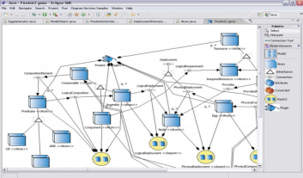

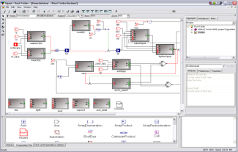




Domain-Specific Modeling (DSM)
DSM specifies a system using domain concept models, and enables code generation from models
Problem Domains
Represent the System
Domain- Specific Modeling Languages
Generate the Code
Low-Level Software Artifacts
…

Slide 6
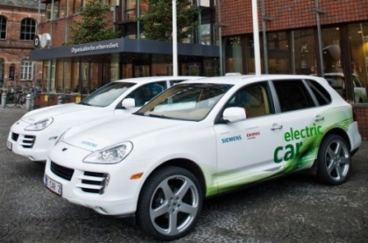

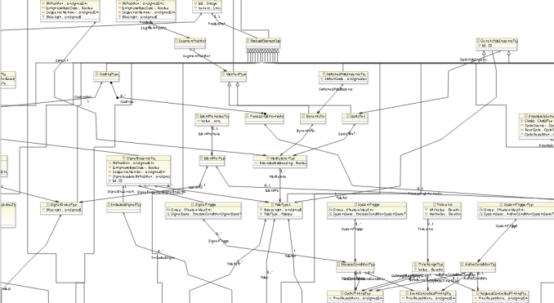

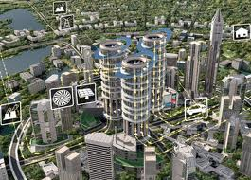
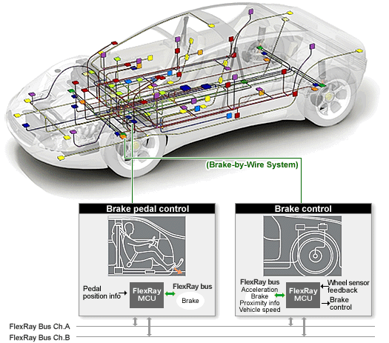
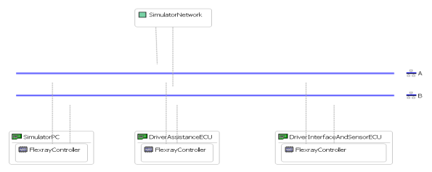
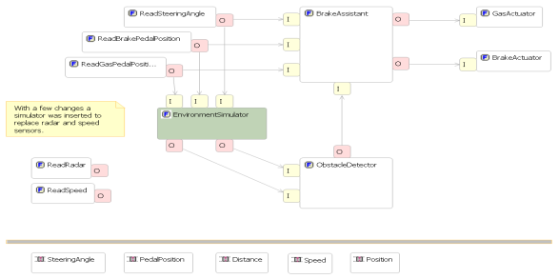
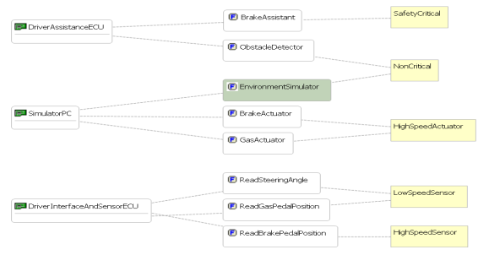
DSM Example – DSM in Automotive Domain
Metamodel
Physical View
Logical View
Users specify the automobile system using models from different perspectives and generate code automatically
Deployment View

Slide 7
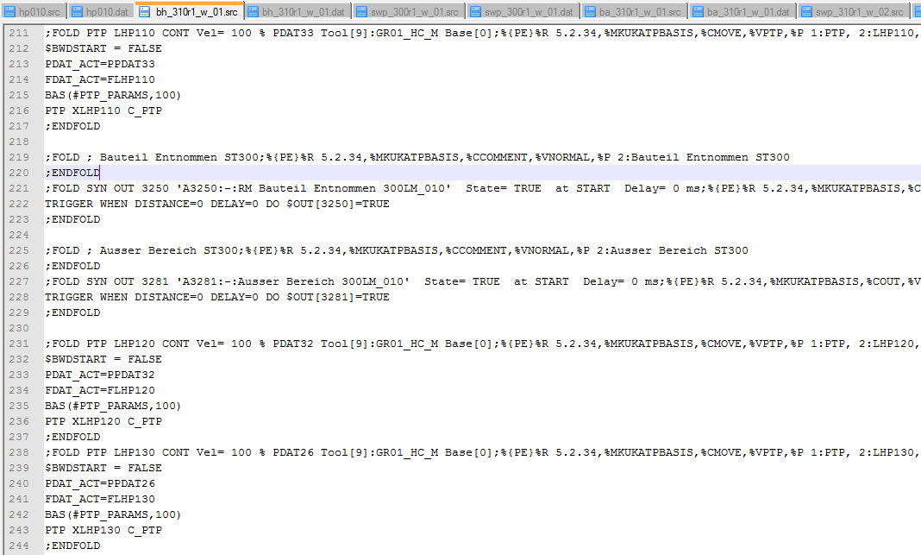
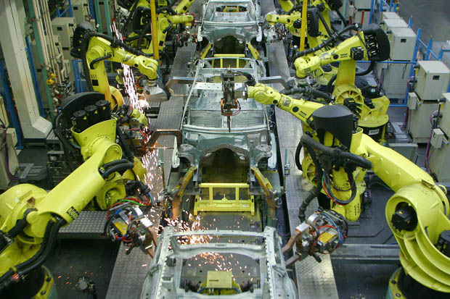
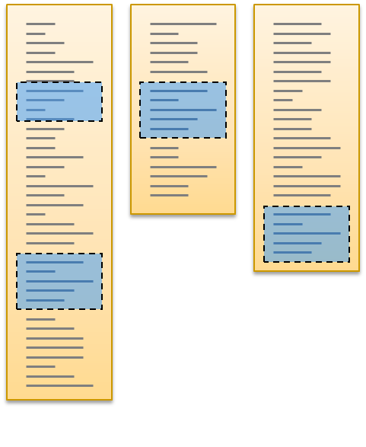
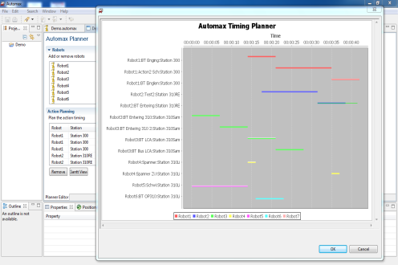
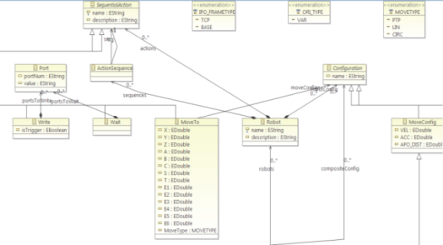
DSM Example – DSM in Robotics
Control Code
Users can plan the schedule, build robot action model, generate code, and analyze timing requirements
Models
Schedule Planning & Analysis

Slide 8
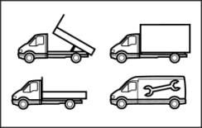



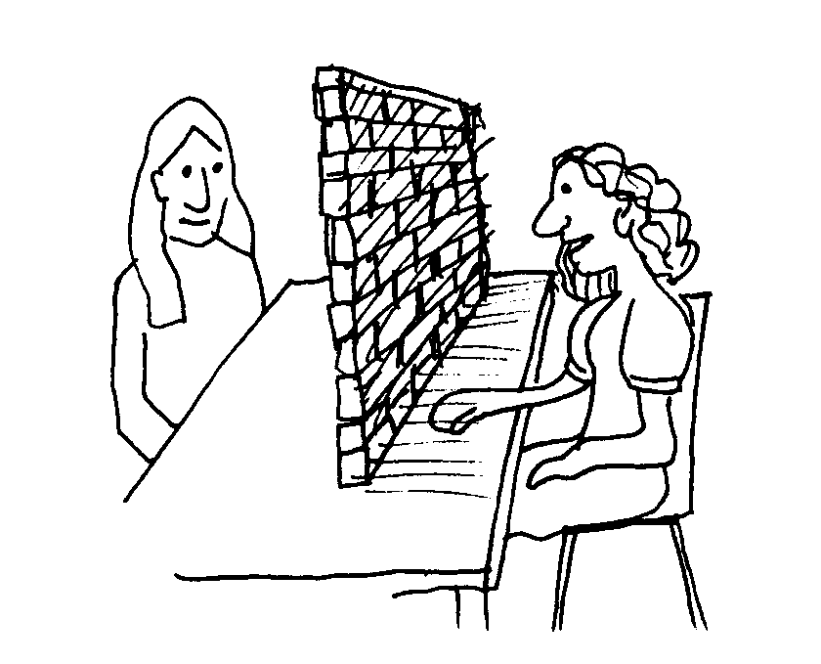










DSM Helps End-User Programming
Software created by professional developers often fails to meet end-user requirements due to the communication gap
End-Users
Java
XML
C/S
Professional Developers

Slide 9
DSM Helps End-User Programming
DSM enables end-users to participate in software development
End-Users
End-User Developers
Upgrade
Using DSM

Slide 10

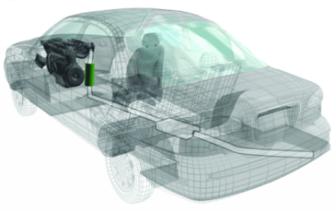
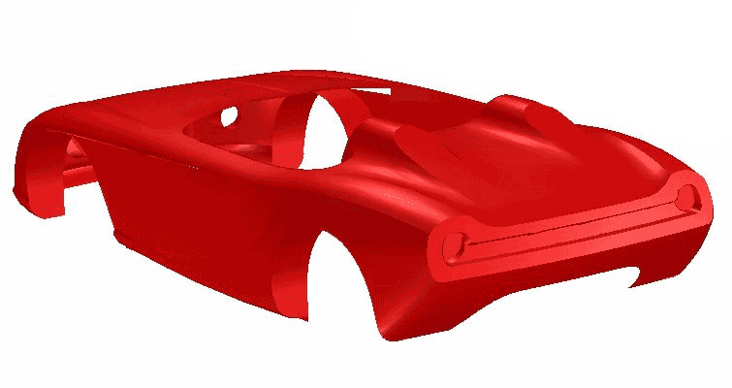




Model Evolution
Software evolution is inevitable
Using DSM, software evolution is realized by model evolution
Metamodel
ΔM0
ΔM1
ΔM2
…
ΔMn
Modeln
Model0
Model1
Model2
Code0
ΔC0
Code1
ΔC1
Code2
ΔC2
…
ΔCn
Code2

Slide 11
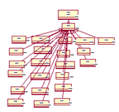
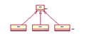
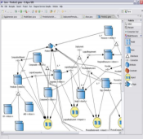
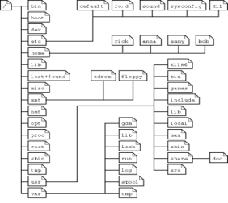

Typical Model Evolution Activities
Model Evolution
Model Scalability
Aspect-Oriented Modeling
Model Management
Model Refactoring
Model Layout
A
B
F
c
d
e
B
B
c
d
e
c
d
e

Slide 12
Model Evolution as Model Transformations
Model Transformation takes as input a model conforming to a given metamodel and produces as output another model conforming to a given metamodel
This research focuses on endogenous model transformations to support model evolution
✓
Exogenous Model Transformation
Endogenous Model Transformation
Metamodel1
Metamodel2
Metamodel1
Model1
Model2
Model
Model’

Slide 13
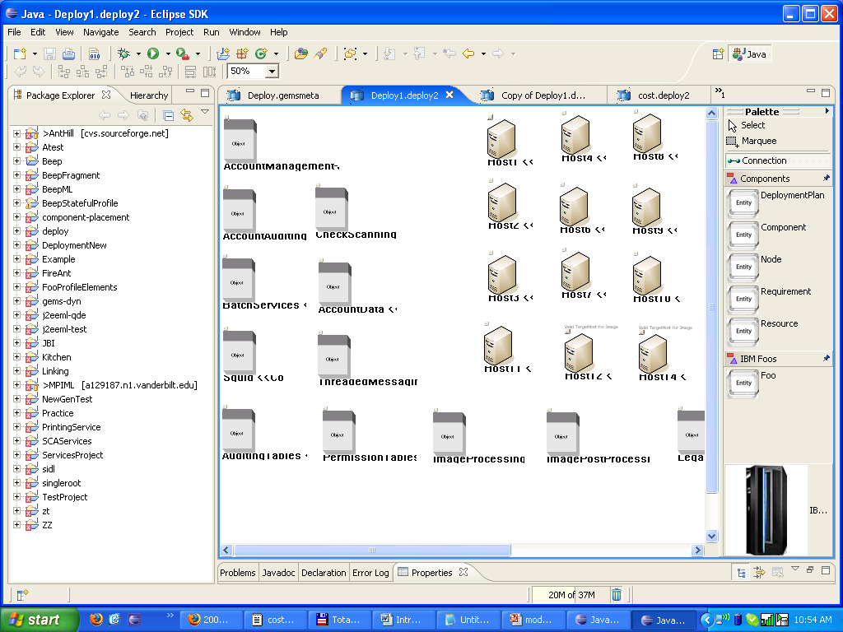
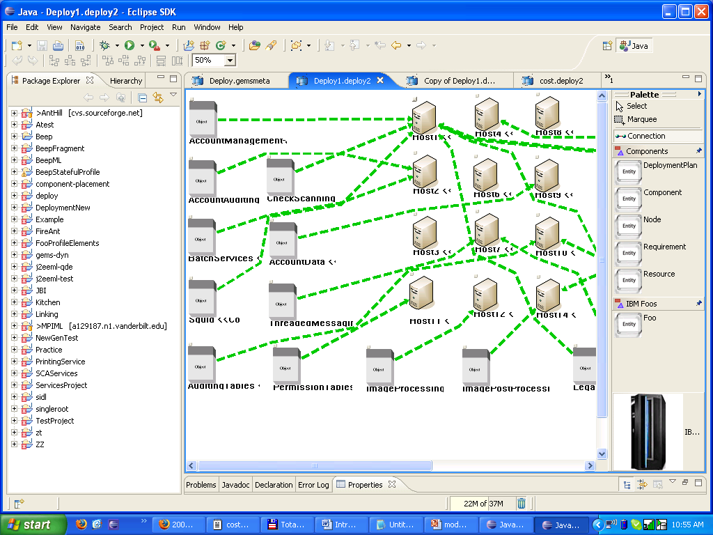

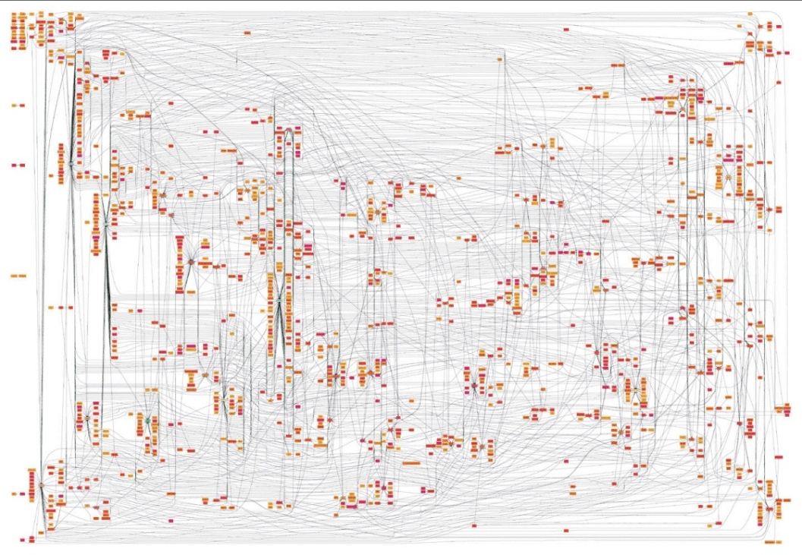


Manual Transformation is Challenging
Manually editing is the most direct way to transform models
Manual editing is
Tedious
Time-consuming
Error-prone

Slide 14
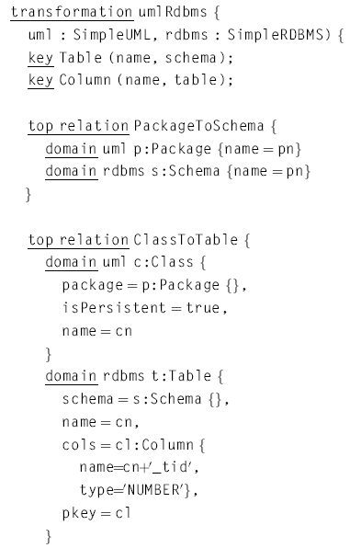
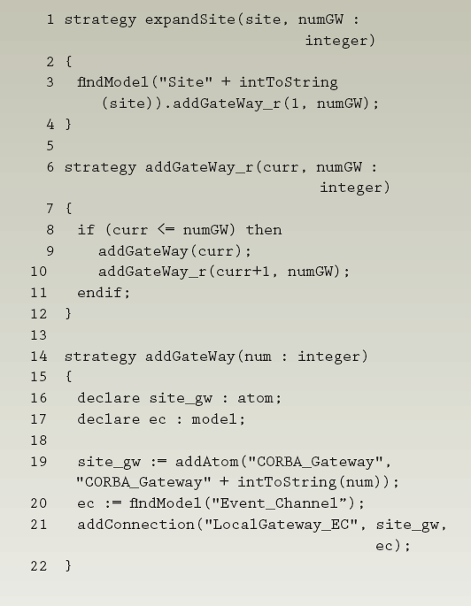
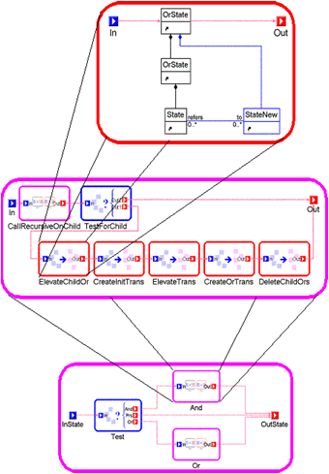
Using Model Transformation Languages
MTLs are specialized languages to implement model transformation tasks
Automate model transformations by programming
Popular Model Transformation Languages
QVT
Query/View/Transformation
GReAT
Graph Rewriting and Transformation
ECL
Embedded Constraint Language

Slide 15
Roadmap
Introduction
Model Transformation Languages (MTLs)
Domain-Specific Modeling
Model Evolution
Motivation
Using and learning MTLs
Reusing MTL Rules
Debugging MTL Rules
Research Objectives
User-Centric
Reuse Support
Debugging Mechanism
Approaches
MTBD
Live-MTBD
MTBD Debugger

Slide 16

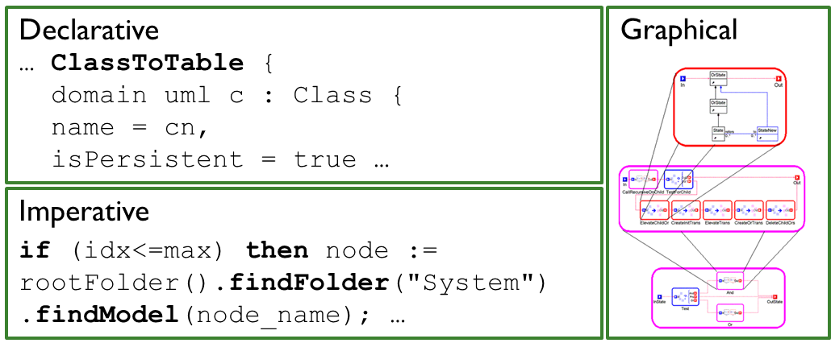
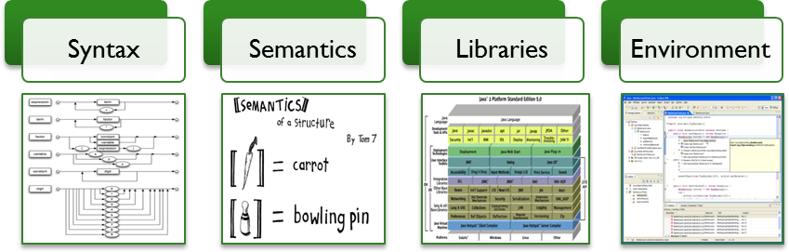

Challenge 1: Difficult to Learn and Use MTLs
Diversity of MTLs
Metamodel
Programming Concepts
End-Users

Slide 17
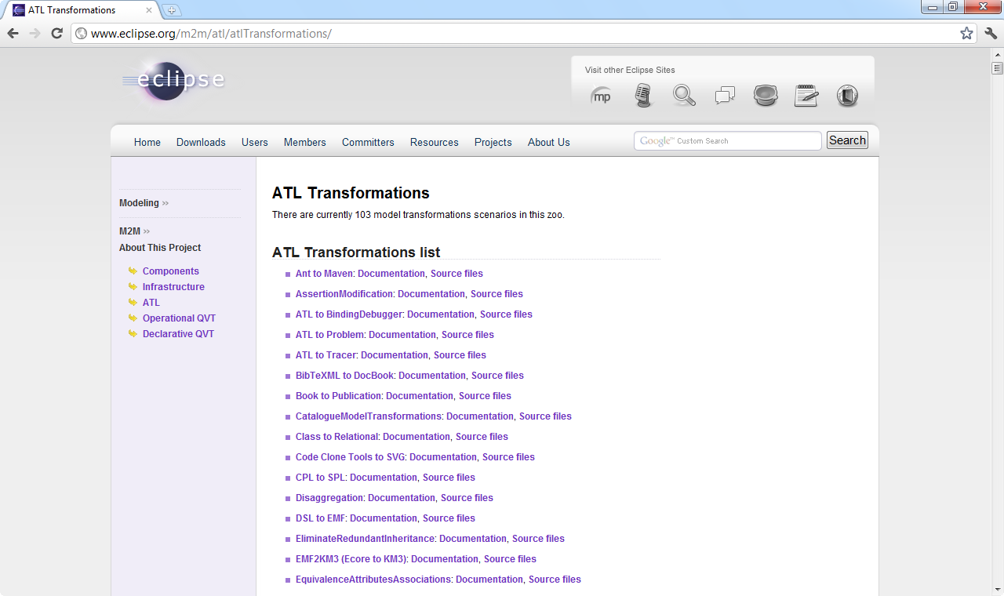
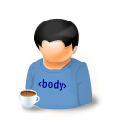







Challenge 2: Limited Support to Reuse MTL Rules
How to Share Rules?
Transparently & Immediately?
MTL Rules
MTL Rules
Rule, Rule, Rule, …
Rule, …
ATL Transformation Zoo
http://www.eclipse.org/m2m/atl/atlTransformations/
How to Find the Correct Rules?
Automatically & Intelligently?
Run & Check
MTL Rules
Models

Slide 18


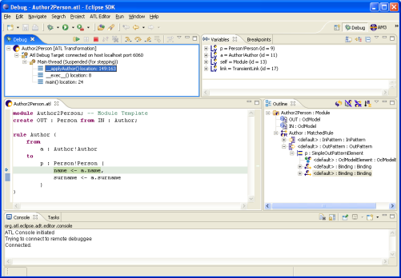
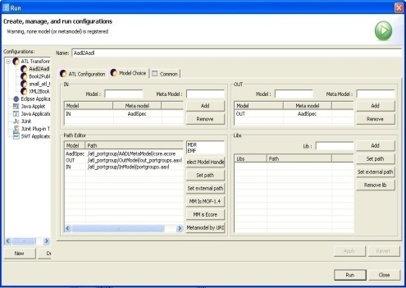
Challenge 3: Lack of an End-User MTL Debugger
Bugs can occur in MTL rules
Most MTLs do not have an associated debugger
Some existing debuggers are at the same level as MTLs, so not appropriate for end-users
Models
Models’
MTL Rules
End-Users

Slide 19
The Challenges Lead to an Irony
A technology meant to enable end-users to participate in software development, does not enable end-users to change and evolve the software
End-Users
End-User Developers
End-Users
Upgrade
Degrade
Using DSM
Using MTL
Modeling System
Model Evolution

Slide 20
Roadmap
Introduction
Model Transformation Languages (MTLs)
Domain-Specific Modeling
Model Evolution
Motivation
Using and learning MTLs
Reusing MTL Rules
Debugging MTL Rules
Research Objectives
User-Centric
Reuse Support
Debugging Mechanism
Approaches
MTBD
Live-MTBD
MTBD Debugger

Slide 21
Research Goal: Support Model Evolution
Enable end-users to participate in and contribute to changing and evolving software models with reusable transformations and debugging support
End-Users
End-User Developers
End-User Developers
User-Centric
Reuse Support
Debugger
Upgrade
Using DSM
Modeling System
Model Evolution

Slide 22



Research Objectives
Model Evolution
Model Transformation By Demonstration (MTBD)
An End-User Centric Model Transformation Approach
Model Refactoring
Model Scalability
Aspect-Oriented Modeling
Model Management
Model Layout
Live-MTBD
Tool Support to Improve Model Transformation Reuse
MTBD Debugger
An End-User Debugging Facility
Live Demonstration
Live Sharing
Live Matching
Pattern Matching
Pattern Execution

Slide 23
Research Objectives: End-User Centric
Separation from knowing MTLs or GPLs
No need to understand Metamodels
Support the five typical model evolution activities
Model Evolution
Model Transformation By Demonstration (MTBD)
An End-User Centric Model Transformation Approach
Model Refactoring
Model Scalability
Aspect-Oriented Modeling
Model Management
Model Layout
Live-MTBD
Tool Support to Improve Model Transformation Reuse
MTBD Debugger
An End-User Debugging Facility
Live Demonstration
Live Sharing
Live Matching
Pattern Matching
Pattern Execution

Slide 24
Research Objectives: Reuse Support
Encourage more reusable model transformation
Enable sharing the transformation transparently at editing time
Provide transformation reuse suggestion support
Model Evolution
Model Transformation By Demonstration (MTBD)
An End-User Centric Model Transformation Approach
Model Refactoring
Model Scalability
Aspect-Oriented Modeling
Model Management
Model Layout
Live-MTBD
Tool Support to Improve Model Transformation Reuse
MTBD Debugger
An End-User Debugging Facility
Live Demonstration
Live Sharing
Live Matching
Pattern Matching
Pattern Execution

Slide 25
Research Objectives: End-User Debugger
Provide needed debugging functionality for MTBD
Hide low-level implementation details
Model Evolution
Model Transformation By Demonstration (MTBD)
An End-User Centric Model Transformation Approach
Model Refactoring
Model Scalability
Aspect-Oriented Modeling
Model Management
Model Layout
Live-MTBD
Tool Support to Improve Model Transformation Reuse
MTBD Debugger
An End-User Debugging Facility
Live Demonstration
Live Sharing
Live Matching
Pattern Matching
Pattern Execution

Slide 26
Roadmap
Introduction
Model Transformation Languages (MTLs)
Domain-Specific Modeling
Model Evolution
Motivation
Using and learning MTLs
Reusing MTL Rules
Debugging MTL Rules
Research Objectives
User-Centric
Reuse Support
Debugging Mechanism
Approaches
MTBD
Live-MTBD
MTBD Debugger

Slide 27
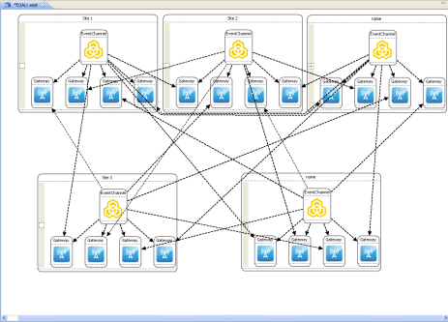
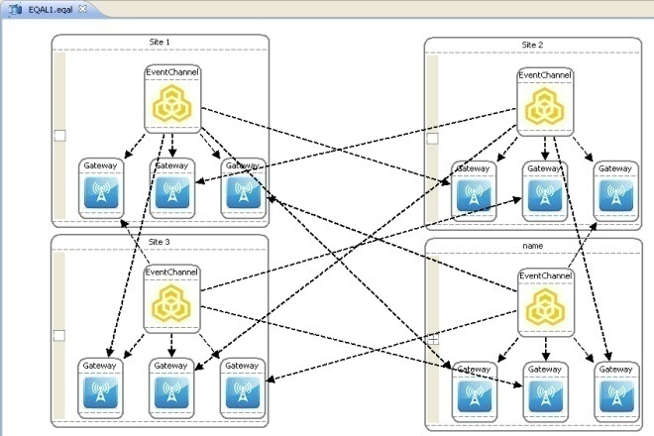



Model Transformation By Demonstration (MTBD)
A complete model transformation framework
Specify and execute model transformations
Users are fully isolated from MTLs and metamodel definitions
Infer and generate model transformation patterns by demonstrating model transformations on concrete examples
Add, Remove, Update

Slide 28









Overview of MTBD
MT Specification
User
Demonstration
Operation
Recording
Operation
Optimization
Pattern
Inference
User
Refinement
MT Execution
Pattern Execution
Pattern
Repository
Correctness Checking
Execution Control

Slide 29
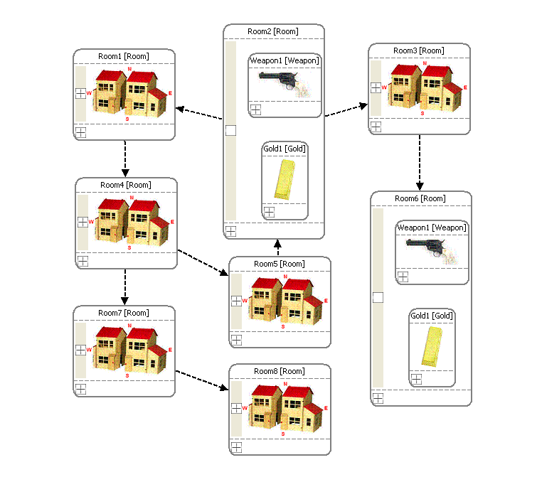
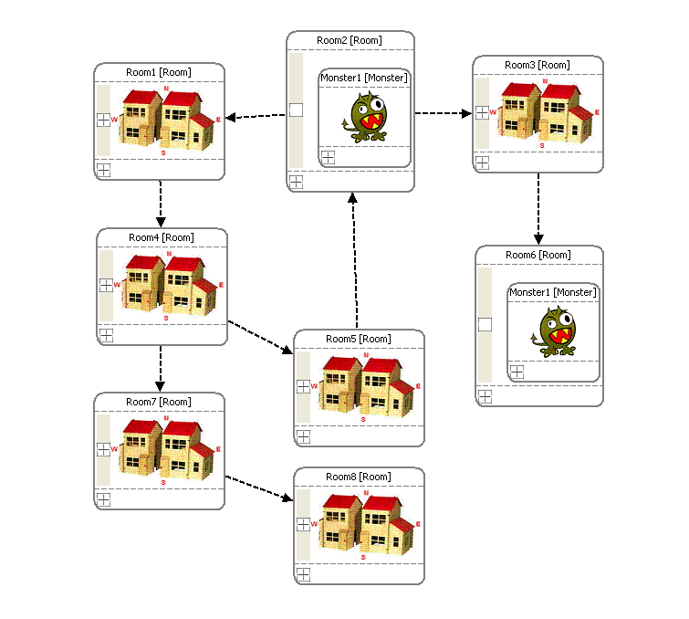
A Model Transformation Example
If a room contains both a weapon (>100) and gold, replace them with a monster having half the power of the weapon
110
55
120
60
Source model with the weapon and gold
Target model with the monster

Slide 30



User Demonstration
User
Demonstration
Edit a sample source model to change it into the desired target model, reflecting the purpose of the transformation
Operation
Recording
Operation
Optimization
Pattern
Inference
User
Refinement
Before Demonstration
After Demonstration
Pattern Execution
Pattern
Repository
Attribute refactoring to demonstrate attribute transformation on a concrete model
100 / 2
Correctness Checking
Execution Control
Notes:
Recapture attribute refactor figure!
Insert attribute figures.

Slide 31

Operation Recording
User
Demonstration
All the user operations performed during the demonstration will be recorded, as well as the related context information
Operation
Recording
Operation
Optimization
Pattern
Inference
User
Refinement
Step | Operation Type | Detail
1 | Delete Element | Root.MazeFolder.Room2.Weapon1
2 | Delete Element | Root.MazeFolder.Room2.Gold1
3 | Add Element | Root.MazeFolder.Room2 (Monster1)
4 | Update Element | Root.MazeFolder.Room2.Monster1.power (Root.MazeFolder.Room2.Weapon1.power / 2)
Pattern Execution
Pattern
Repository
Correctness Checking
Execution Control

Slide 32



Operation Optimization
Users may perform meaningless operations that need to be optimized
User
Demonstration
…
…
Step | Operation
1 | Add a Monster1 in Room2
2 | Add the Gold1 in Room2
… | …
… | Delete Monster1 in Room2
Operation
Recording
Operation
Optimization
Pattern
Inference
User
Refinement
for each op in the input operation list
switch (op.type)
case ADD_ELEM:
for each op_temp after the current op in the list
if op_temp.type == REMOVE_ELEM and op_temp removes what op added
and the element was not referred in between
then remove both op and op_temp from the list
case MODIFY_ELEM:
traverse the final model instance and search the element being modified
if not found then remove op from the list
… …
Pattern Execution
Pattern
Repository
Correctness Checking
Execution Control
Notes:
Other opts

Slide 33

Pattern Inference
User
Demonstration
A transformation pattern consists of:
Transformation precondition (When and Where)
Transformation actions (How)
Operation
Recording
Operation
Optimization
Pattern
Inference
User
Refinement
Precondition (Elements needed)
elem1.elem2.elem3.elem4
elem1.elem2.elem3.elem6
elem1.elem2.elem3 (elem5)
elem1.elem2.elem3.elem5
Precondition (Elements Type)
elem1 – Root
elem2 – MazeFolder
elem3 – Room
elem4 – Monster
elem5 – Weapon
elem6 – Gold
Pattern Execution
Pattern
Repository
No. | Transformation Actions
1 | Remove elem4
2 | Remove elem6
2 | Add elem5 in elem3
3 | Set elem5.power = elem4.power / 2
Correctness Checking
Execution Control

Slide 34

User Refinement
The initially inferred pattern is usually not accurate:
Preconditions are not specific enough
Transformation actions are not generic enough
User
Demonstration
Precondition (Elements needed)
elem1.elem2.elem3.elem4 (elem4 > 100)
elem1.elem2.elem3.elem6
elem1.elem2.elem3 (elem5)
elem1.elem2.elem3.elem5
Precondition (Elements Type)
elem1 – Root
elem2 – MazeFolder
elem3 – Room
elem4 – Monster
elem5 – Weapon
elem6 – Gold
Operation
Recording
Operation
Optimization
Pattern
Inference
User
Refinement
> 100
Pattern Execution
Pattern
Repository
Weapon1.strength > 100
User-centric interfaces are provided to enable user refinement:
Users continue to work at the model instance level
Isolate users from knowing MTLs and metamodels
Correctness Checking
Execution Control
Notes:
Recapture the figure.

Slide 35

Pattern Repository
All the finalized patterns are stored in the repository for future reuse
User
Demonstration
Operation
Recording
Operation
Optimization
Pattern
Inference
User
Refinement
Pattern Execution
Pattern
Repository
Correctness Checking
Execution Control
Notes:
Recapture the figure.

Slide 36


Pattern Execution
The execution engine is responsible for:
Precondition matching
Execution of transformation actions
User
Demonstration
No. | Transformation Actions
1 | Remove elem4
2 | Remove elem6
2 | Add elem5 in elem3
3 | Set elem5.power = elem4.power / 2
Operation
Recording
Operation
Optimization
Pattern
Inference
User
Refinement
>100
Pattern Execution
Pattern
Repository
Traverse the whole model instance and list all elements
Start to match the elements in the precondition one-by-one
Backtracking algorithm is used
Correctness Checking
Execution Control
Notes:
alg

Slide 37
Correctness Checking
User
Demonstration
To prevent the execution from violating the metamodel definitions:
Each execution is logged
Correctness checking is performed after each execution
After a violation occurs, all the executed operations will be undone
Operation
Recording
Operation
Optimization
Pattern
Inference
User
Refinement
Pattern Execution
Pattern
Repository
Correctness Checking
Execution Control

Slide 38

Execution Control
An execution controller is built to enable:
Execute multiple transformation patterns
Control the execution sequence of multiple transformation patterns
Control the number of execution times
User
Demonstration
Operation
Recording
Operation
Optimization
Pattern
Inference
User
Refinement
Pattern Execution
Pattern
Repository
Correctness Checking
Execution Control

Slide 39
Power of MTBD?
MT Specification
User
Demonstration
Operation
Recording
Operation
Optimization
Pattern
Inference
User
Refinement
MT Execution
Pattern Execution
Pattern
Repository
Correctness Checking
Execution Control

Slide 40









Practical and Incremental Development of MTBD
Model Evolution
Model Scalability
Aspect-Oriented Modeling
Model Management
Model Refactoring
Model Layout
For each type of model evolution:
Identify the critical requirements
Update MTBD to make it work
User
Demonstration
Operation
Recording
Operation
Optimization
Pattern
Inference
User
Refinement
Pattern Execution
Pattern
Repository
Correctness Checking
Execution Control

Slide 41


E1 - Model Refactoring
Refactoring is the process of changing the internal structure of a software system without modifying its external functional behavior
Model refactoring is as essential as code refactoring
Support Model Refactoring using MTBD
Precise precondition specification
Generic refactoring
Manual selection of subpart of models
User input attributes
UML Model Refactoring – Extract Super Class
Model Refactoring
Notes:
Why semantics

Slide 42



E2 - Model Scalability
Model scalability is to build a complex model from a base model by adding or replicating its model elements, connections or substructures
Support Model Scalability using MTBD
Generic replication
Rich attribute computation
Execution of multiple patterns
Control of execution times
EQAL Model with 3 Sites
EQAL Model with 4 Sites
EQAL Model with 6 Sites
Model Scalability

Slide 43

E3 - Aspect-Oriented Modeling
AOM enhances the modularity at the model level by allowing the separation of concerns.
Support AOM using MTBD
Precise specification of preconditions (structural & attributes)
Textual constraints weaving process
Aspect- Oriented Modeling
Weave Logging control to ESML models using MTBD

Slide 44





E4 - Model Management
Model management refers to general model maintenance activities beyond refactoring, aspect, and scalability tasks
Static Model Maintenance
Models@Runtime Maintenance
Model Management
Runtime Models Reflecting the Status of the Applications
Applications Running in Cloud Server

Slide 45



E5 - Model Layout
The layout of models specifies where and how each model element or connection should be placed in the model editor
Model layout can be destroyed after model transformation
SRN Model with 2 Events
SRN Model with 4 Events
Default Auto-Layout function does not offer flexibility to customize the layout
Model Layout
SRN Model with 4 Events using Auto-Layout

Slide 46





E5 - Model Layout
MT Specification
User
Demonstration
Demonstrate Layout Configuration
Absolute Coordinates
Operation
Recording
Operation
Optimization
Pattern
Inference
User
Refinement
MT Execution
Pattern Execution
Pattern
Repository
Relative Coordinates (to boundary/element)
Correctness Checking
Execution Control
Model Layout

Slide 47


E5 - Model Layout
Demonstrate layout configuration by confirming the desired absolute and relative locations
Model Layout
SRN Model with 2 Events
SRN Model with 4 Events

Slide 48

Evaluation Metrics
1
Generality
2
Practicality
3
Productivity
4
User-Friendliness

Slide 49



Evaluation Metrics - Generality
1
Generality
2
Practicality
3
Productivity
4
User-Friendliness
The approach is applicable to different modeling languages for various domains
The plug-in is applicable to all modeling languages in the GEMS editor

Slide 50
Evaluation Metrics - Practicality
1
Generality
2
Practicality
3
Productivity
4
User-Friendliness
MTBD is applicable to the main types of model evolution activities
Model Evolution
Model Scalability
Aspect-Oriented Modeling
Model Management
Model Refactoring
Model Layout

Slide 51




Evaluation Metrics - User-Friendliness
1
Generality
2
Practicality
3
Productivity
4
User-Friendliness
MTBD does not use any MTL or MTL engine
MTBD does not apply any GPL concepts
End-Users
MTLs
Users are separated from any Metamodel definitions when using MTBD
End-Users
Metamodels

Slide 52



Evaluation Metrics - Productivity
1
Generality
2
Practicality
3
Productivity
4
User-Friendliness
MTBD aims at requiring less effort to implement a model evaluation task
Compare MTBD with manual editing and MTLs in terms of the mouse / keyboard operations and SLOC
Manual edit
User
Demonstration
MTL Rules
MTBD

Slide 53
Evaluation Metrics - Productivity
Compare the effort on completing the same examples using different approaches
Example | Manual Edit | MTL(ECL) | MTBD
Model Refactoring Extract Super Class | 9 Ops – 3 classes 27 Ops – 30 classes | 28 SLOC | 9 Editing Ops 3 Refinement Ops
Model Scalability Scale SRN Models | 57 Ops – 2 to 4 events 159 Ops – 4 to 6 events | 170 SLOC | 35 Editing Ops 1 Refinement Ops
Model Scalability Scale EQAL Models | 26 Ops – 3 to 4 sites 175 Ops – 4 to 8 sites | 124 SLOC | 16 Editing Ops 3 Refinement Ops
AOM Weave QoSAML aspects | 6 Ops – 3 strategies 12 Ops – 6 strategies | 23 SLOC | 3 Editing Ops 2 Refinement Ops
AOM Weave ESML aspects | 9 Ops –3 loggings 27 Ops – 9 loggings | 40 SLOC | 4 Editing Ops 8 Refinement Ops
Notes:
Sloc?

Slide 54
MTBD Summary
MTBD is an end-user centric model transformation approach
Users do not need to know MTLs or GPL concepts
Users are isolated from metamodels
MTBD can be applied to the main model evolution tasks
Model Refactoring
Model Scalability
Aspect-Oriented Modeling
Model Management
Model Layout
MTBD is a general practice model transformation solution, which also improves the productivity of performing model transformation tasks
Notes:
Del?

Slide 55
Roadmap
Introduction
Model Transformation Languages (MTLs)
Domain-Specific Modeling
Model Evolution
Motivation
Using and learning MTLs
Reusing MTL Rules
Debugging MTL Rules
Research Objectives
User-Centric
Reuse Support
Debugging Mechanism
Approaches
MTBD
Live-MTBD
MTBD Debugger

Slide 56




A Motivating Example of MT Reuse
Model Real-time Embedded System Functions
Chris (EE)
Yu (CS)

Slide 57



Model Transformation Case 1
Modeling ADC (Analog-to-Digital Converter)
19 operations
1. Add elements
2. Add connections
3. Setup attributes
Modeling an ADC function involves a sequence of 19 different operations.
Chris (EE)

Slide 58

Model Transformation Case 2
Applying Buffering Function
If a function has a large WCET, other functions that depend on it should apply a buffering function to ensure the correct data flow.
Yu (CS)

Slide 59


Model Transformation Knowledge Reuse
Yu (CS)
Chris (EE)
Mr. Senior

Slide 60

Problem 1: How to Encourage More Patterns
When an editing pattern is identified, users often have to explicitly re-do the editing, and re-demonstrate the pattern
19 operations
1. Add elements
2. Add connections
3. Setup attributes
Again!
Chris (EE)

Slide 61

Solution: Live Demonstration
MT Specification
User
Demonstration
Live Demonstration
Operation
Recording
Operation
Optimization
Pattern
Inference
User
Refinement
MT Execution
Pattern Execution
Pattern
Repository
Correctness Checking
Execution Debugging

Slide 62

Live Demonstration
User does not need to start a demonstration explicitly
Demonstration can be made from the history editing operations
Chris (EE)

Slide 63



Problem 2: How to Share Patterns?
How to share the patterns directly at editing time?

Slide 64
Solution: Live Sharing
Specification
User
Demonstration
Live Demonstration
Operation
Recording
Operation
Optimization
Pattern
Inference
User
Refinement
Execution
Pattern Execution
Live Pattern
Sharing
Correctness Checking
Execution Debugging
Sharing

Slide 65



Live Sharing
Generated patterns are saved in a centralized repository
Serialize pattern objects and communicate with server using Java RMI

Slide 66

Problem 3: How to Find Correct Patterns?
How do I know if there are reusable patterns in the repository?
How do I know if it is the correct pattern to reuse?

Slide 67

Solution: Live Matching
Specification
User
Demonstration
Live Demonstration
Operation
Recording
Operation
Optimization
Pattern
Inference
User
Refinement
Execution
Pattern Execution
Live Pattern
Sharing
Live Pattern Matching
Correctness Checking
Execution Control
Matching & Sharing

Slide 68


Live Matching
Patterns in the repository are automatically matched based on the current selection in the model editor

Slide 69
Live-MTBD Summary
Live-MTBD
Live Demonstration, provides a more general demonstration environment that allows users to specify transformation patterns based on their editing history
Live Sharing, a centralized model transformation pattern repository, has been built so that transformation patterns can be reused across different editors
Live Matching, automatically matches the saved transformation patterns at modeling time, and provides editing suggestions and guidance to users during editing
We believe that integrating all the features together can improve reuse of model transformation patterns

Slide 70
Roadmap
Introduction
Model Transformation Languages (MTLs)
Domain-Specific Modeling
Model Evolution
Motivation
Using and learning MTLs
Reusing MTL Rules
Debugging MTL Rules
Research Objectives
User-Centric
Reuse Support
Debugging Mechanism
Approaches
MTBD
Live-MTBD
MTBD Debugger

Slide 71

The Need for a MTBD Debugger
MT Specification
User
Demonstration
Users can make mistakes, and bugs can happen.
Users can make mistakes, and bugs can emerge
Operation
Recording
Operation
Optimization
Pattern
Inference
User
Refinement
Reusing existing patterns may cause unknown errors
MT Execution
Pattern Execution
Pattern
Repository
Correctness Checking
Execution Control
Transformation Pattern
Models
Models’

Slide 72
MTBD Debugger: Being User-Centric
The debugger should be at the same level of abstraction as MTBD, and be domain-focused
End-Users
End-User Developers
End-User Developers
End-User Developers
Using MTBD Debugger
Using MTBD
Upgrade
Using DSM
Modeling System
Model Evolution
Debugging Model Evolution

Slide 73
Overview of MTBD Debugger
MT Specification
User
Demonstration
Transformation Pattern
Models
Models’
User
Refinement
Operation
Recording
Operation
Optimization
Pattern
Inference
Pattern Matching View
Precondition
Pattern Execution View
Transformation Actions
MT Execution
Pattern Execution
Pattern
Repository
MTBD Debugger
Correctness Checking
Execution Control

Slide 74



MTBD Debugger Case Study
Replace Monster with Weapon + Gold
(Monster.Strength > 100)
120
120
Sequence | Operation Performed
1 | Remove Monster1 in Root.TextGameFolder.Room2
2 | Add a Weapon in Root.TextGameFolder.Room2
3 | Add a Gold in Root.TextGameFolder.Room2
4 | Set Root.TextGameFolder.Room2.Weapon.strength = Monster1.strength = 120
5 | Set precondition on Monster1: Monster1.strength > 10
This error may cause the generated pattern to be over-matched in the model

Slide 75


MTBD Debugger In Action
Pattern Execution View
Step-through each transformation action
Display relative information
Track the currently matched elements
25
Pattern Matching View
Display the information about the matched elements
Display the precondition

Slide 76
MTBD Debugger In Action
Common Bugs
Over-Matched Precondition
Under-Matched Precondition
Incorrect Generic Operation
Choosing Wrong Element
Incorrect Attribute Expression
25

Slide 77
MTBD Debugger In Action
Common Bugs
Over-Matched Precondition
Under-Matched Precondition
Incorrect Generic Operation
Choosing Wrong Element
Incorrect Attribute Expression
25

Slide 78
MTBD Debugger In Action
Common Bugs
Over-Matched Precondition
Under-Matched Precondition
Incorrect Generic Operation
Choosing Wrong Element
Incorrect Attribute Expression
25

Slide 79
MTBD Debugger In Action
Common Bugs
Over-Matched Precondition
Under-Matched Precondition
Incorrect Generic Operation
Choosing Wrong Element
Incorrect Attribute Expression
25

Slide 80
MTBD Debugger Summary
MTBD Debugger assists in debugging MTBD transformation patterns
Pattern Matching View checks the matching elements
Pattern Execution View traces the transformation actions
MTBD Debugger is at the same level of abstraction as MTBD
Users do not need to know MTLs
Users are isolated from metamodels

Slide 81
Contributions
Enable end-users to participate in changing and evolving software models with reusable transformations and debugging support
Model Transformation By Demonstration (MTBD)
An end-user centric model transformation approach to support model evolution activities
Live-MTBD
Tool support to improve the reuse of model transformations
MTBD Debugger
An end-user centric debugging facility for MTBD

Slide 82
Future Work
Enhance MTBD Capability
Realize more types of demonstration
Improve the inference engine (negative demonstrations)
Support more types of model evolution (e.g., model composition)
Improve Live-MTBD Tool Support
Add management feature for Live Sharing
Improve the performance of Live Matching
MTBD Debugger
Improve user experience by adding graphical representations
Apply MTBD to Exogenous Model Transformation
Apply MTBD to Support Model Versioning

Slide 83
Related Work
MTBE: infer model transformation rules from the mappings between a source and a target model instances
Varró ‘06, Strommer ’07, Robbes ’08, Wimmer ‘08, Balogh ’09, Brosch ‘09
MT Reuse: adapt MT rules to new metamodels and apply MT templates
Iacob ‘08, Bergmann ’09, Balogh ‘06, Rath ’08, Bergmann ’09, Sen ‘10
MT Debugging: MTL debuggers and forensic MT debugging
Allilaire ‘06, Hillberd ‘07, Schoenboeck ‘10

Slide 84
Publications
Journals
1. Yu Sun, Jules White, and Jeff Gray, “A Demonstration-based Model Transformation Approach to Automate Model Scalability,” Journal of Software and Systems Modeling, 2011 (Under review)
2. Yu Sun, Jeff Gray, Jules White, Romain Delamare, and Benoit Baudry, “Automating the Management of Non-functional System Properties using Demonstration-based Model Transformation,” Journal of Software Maintenance and Evolution, 2011 (Under review)
3. Zekai Demirezen, Yu Sun, Jeff Gray, and Frédéric Jouault, “Enabling Tool Reuse and Interoperability through Model-Driven Engineering,” Journal of Computational Methods in Science and Engineering (JCMSE), vol. 10, no. 2, September 2010, pp. 187-202.
Book Chapters
4. Yu Sun, Jeff Gray, Gerti Kappel, Philip Langer, Manuel Wimmer, and Jules White, “A WYSIWYG Approach to Support Layout Configuration in Model Evolutions,” Emerging Technologies for the Evolution and Maintenance of Software Models, edited by Jörg Rech and Christian Bunse, IGI Global, 2011.
5. Yu Sun, Jules White, Jeff Gray, and Aniruddha Gokhale, “Model-Driven Automated Error Recovery in Cloud Computing,” Model-driven Analysis and Software Development: Architectures and Functions, edited by Janis Osis and Erika Asnina, Idea Group, IGI Global, 2011, pp. 136-155
Conferences and Workshops
6. Yu Sun, Jeff Gray, Christoph Wienands, Michael Golm, and Jules White, “A Demonstration-based Approach to Support Live Transformations in a Model Editor,” International Conference on Model Transformation (ICMT), Zurich, Switzerland, June 2011.
7. Ferosh Jacob, Yu Sun, Jeff Gray, Puri Bangalore, “A Platform-Independent Tool for Modeling Parallel Programs,” ACM Southeast Conference, Kennesaw, GA, March 2011.
8. Yu Sun, Christoph Wienands, and Meik Felser, “Apply Model-Driven Design and Development to Distributed Time-Triggered Systems,” International Conference on Engineering and Meta-Engineering (ICEME), Orlando, FL, March 2011.
9. Yu Sun, Jules White, and Jeff Gray, “Model Transformation by Demonstration,” International Conference on Model Driven Engineering Languages and Systems (MoDELS), Springer-Verlag LNCS 5795, Denver, CO, October 2009, pp. 712-726.
10. Zekai Demirezen, Yu Sun, Jeff Gray, and Frederic Jouault, “Supporting Tool Reuse with Model Transformation,” International Conference on Software and Data Engineering (SEDE), Las Vegas, NV, June 2009, pp. 119-125.
11. Yu Sun, Zekai Demirezen, Frédéric Jouault, Robert Tairas, and Jeff Gray, “Tool Interoperability through Model Transformations,” International Conference on Software Language Engineering (SLE), Springer-Verlag LNCS 5452, Toulouse, France, September 2008, pp. 178-187.
12. Ritu Arora, Yu Sun, Zekai Demirezen, and Jeff Gray, “Profiler Instrumentation Using Metaprogramming Techniques,” ACM Southeast Conference, Auburn, AL, March 2008.Systems (MoDELS), LNCS 5421, Toulouse, France, 09/08: 332-342.

Slide 85
Publications
13. Yu Sun, Hyun Cho, Jeff Gray, and Jules White, “Assisting Feature Model Configuration Knowledge Reuse using Demonstration-based Model Transformation,” Workshop on Product Line Approaches in Software Engineering (PLEASE), held at ICSE 2011, Honolulu, HI, May 2011.
14. Hyun Cho, Yu Sun, Jules White, Jeff Gray, “Key Challenges for Modeling Language Creation By Demonstration,” Workshop on Flexible Modeling Tools, held at ICSE 2011, Honolulu, HI, May 2011.
15. Yu Sun, Jeff Gray, Philip Langer, Manuel Wimmer, and Jules White, “A WYSIWYG Approach for Configuring Model Layout using Model Transformations,” 10th Workshop on Domain-Specific Modeling (DSM), held at SPLASH 2010, Reno, NV, October 2010.
16. Yu Sun, Jeff Gray, and Jules White, “MT-Scribe: A Flexible Tool to Support Model Evolution,” Workshop on Flexible Modeling Tools (FlexiTools), held at SPLASH 2010, Reno, NV, October 2010.
17. Yu Sun, Zekai Demirezen, Marjan Mernik, Jeff Gray, and Barrett Bryant, “Is My DSL a Modeling or Programming Language?” Workshop on Domain-Specific Program Development (DSPD), held at International Conference on Generative Programming and Component Engineering (GPCE), Nashville, TN, October 2008.
18. Yu Sun, Zekai Demirezen, Tomaz Lukman, Marjan Mernik, and Jeff Gray, “Model Transformations Require Formal Semantics,” Workshop on Domain-Specific Program Development (DSPD), held at International Conference on Generative Programming and Component Engineering (GPCE), Nashville, TN, October 2008.
Doctoral Symposium
19. Yu Sun, “Model Transformation by Demonstration,” Doctoral Symposium, International Conference on Object-Oriented Programming, Systems, Languages and Applications (OOPSLA), Orlando, FL, October 2009.
20. Yu Sun, “Model Transformation by Demonstration,” Doctoral Symposium, International Conference on Model Driven Engineering Languages and Systems, Denver, CO, October 2009.
Tool Demonstrations
21. Yu Sun, Jeff Gray, and Jules White, “MT-Scribe: An End-User Approach to Automate Software Model Evolution,” Tool Demonstration, International Conference on Software Engineering (ICSE), Honolulu, HI, May 2011.
22. Yu Sun, Jules White, and Jeff Gray, “MT-Scribe: A Tool for Recording and Inferring Model Transformations,” Tool Demonstration, International Conference on Object-Oriented Programming, Systems, Languages and Applications (OOPSLA), Orlando, FL, October 2009.
Posters
23. Yu Sun, “An End-User Demonstration Approach to Support Aspect-Oriented Modeling,” Student Research Competition, International Conference on Software Engineering (ICSE), Honolulu, HI, May 2011.
24. Yu Sun, “Model Scalability Using a Model Recording and Inference Engine,” Students Research Competition, International Conference on Object-Oriented Programming, Systems, Languages and Applications, Reno, NV, October 2010.
25. Yu Sun, “Supporting Model Evolution through Demonstration-based Model Transformation,” Students Research Competition, International Conference on Object-Oriented Programming, Systems, Languages and Applications, Orlando, FL, October 2009.

Slide 86

Publications
1. Sun et al., SoSym 2011
2. Sun et al., JSME 2011
Model Evolution
Model Scalability
Aspect-Oriented Modeling
Model Management
Model Refactoring
Model Layout
6. Sun et al., ICTM 2011
9. Sun et al., MODELS 2009
9. Sun et al., MODELS 2009
5. Sun et al., IGI 2010
4. Sun et al., IGI 2011

Slide 87

Thank you
Personal:
http://www.cis.uab.edu/yusun
Model Transformation By Demonstration:
http://www.cis.uab.edu/softcom/mtbd
SoftCom Laboratory:
http://www.cis.uab.edu/softcom
Model Transformation By Demonstration

